Slide 1
Digital Marketing Database
Javier Chapto
14081525

Slide 2
This database's objetive is to help anyone that is running Google Ads campaigns to analyze performance. The following definitions illustrate some important Google Ads metrics and components:
-- Google Ads Search: Ads appearing in searches in google.com
-- Google Ads Display: Ads appearing in websites and apps
-- Prospecting: Type of campaign with ads shown to users that didn’t visit the client's website.
-- Remarketing: Type of campaign with ads shown to users that already visited the client's website.
-- Impressions: Number of times an ad is displayed to users.
-- Clicks: Number of times an ad is clicked.
-- Cost: Money spent on ads.
-- Conversions: Desirable action on the advertiser’s website after clicking an ad. For example, sale or form completed.
-- Campaign Name: Campaigns have audiences and ad creatives inside. One audience can have many campaigns, and one campaign can have many audiences. Also, one ad creative can have many campaigns, and one campaign can have many ad creatives.
-- Audience name: Audience determines how the ads are targeted. For example, Men from 20 to 40 years old in Sydney, who have an interest in digital marketing. An audience is created and assigned a name by the user.
-- Creative Name: The creative is what is shown to the user in the ad. Every creative is assigned a name by the user.

Slide 3
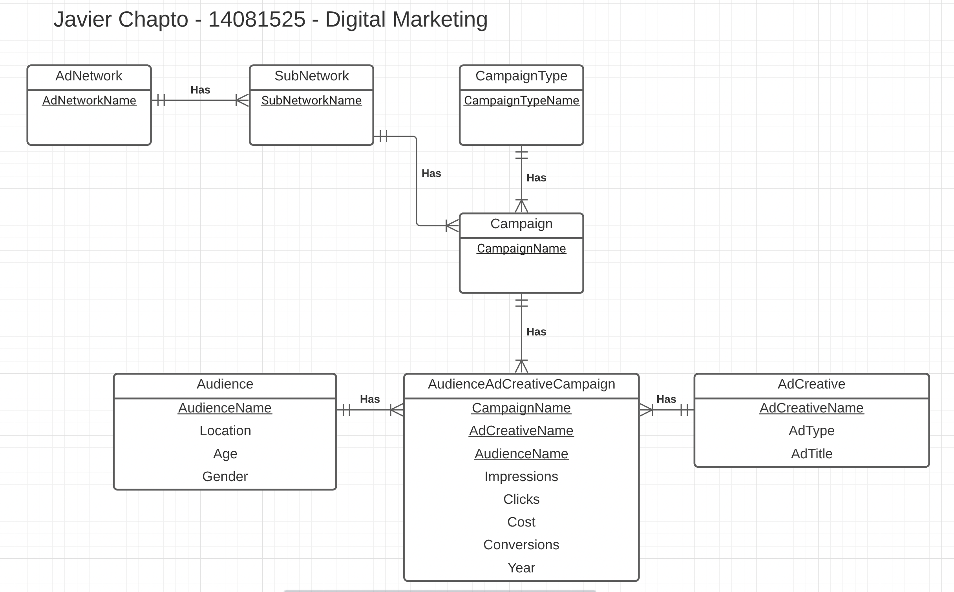

Slide 4
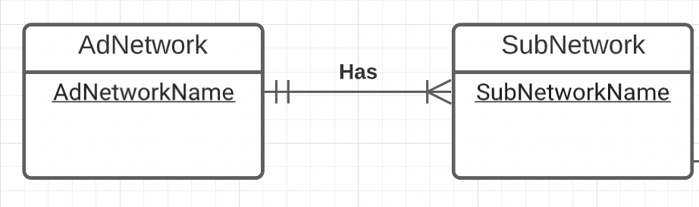
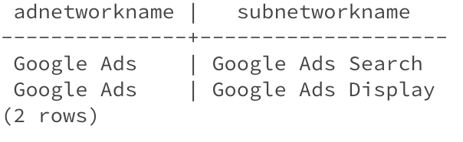
One to many relationship

Slide 5
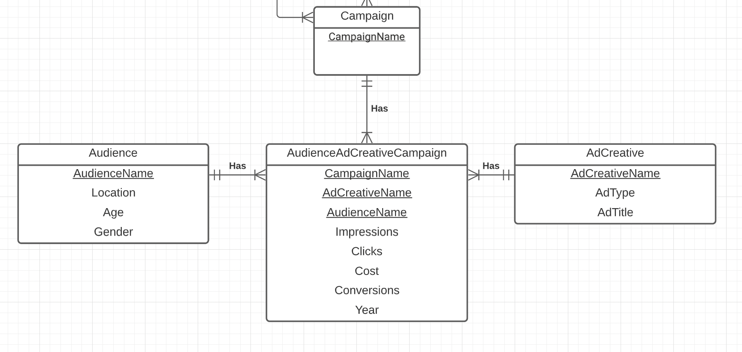
Many to many relationship

Slide 6
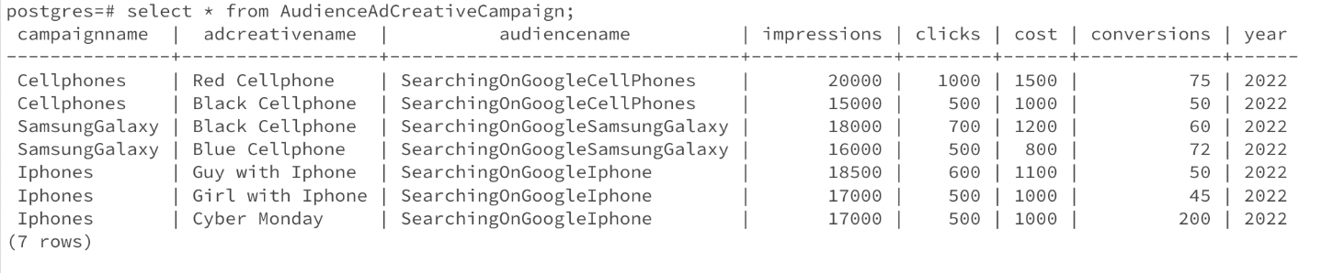
A simple query of a single table: This query shows the impressions, clicks, cost and conversions, in a determined year, of an ad that uses certain audience, and is inside a certain campaign.
postgres=# select * from AudienceAdCreativeCampaign;

Slide 7
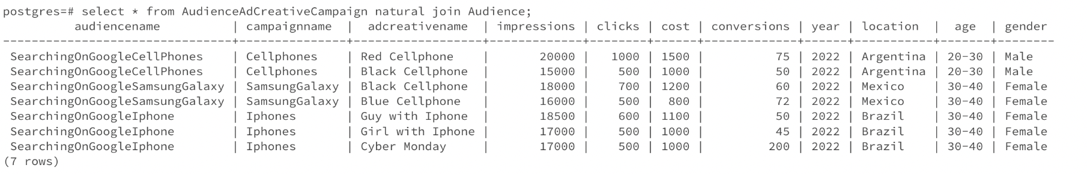
A query which uses the words "natural join": This query shows the impressions, clicks, cost and conversions, in a determined year, of an ad that uses certain audience, and is inside a certain campaign. As it is joined with the audience table, it also shows some attributes of the audience such as location, age and gender.
postgres=# select * from AudienceAdCreativeCampaign natural join Audience;

Slide 8
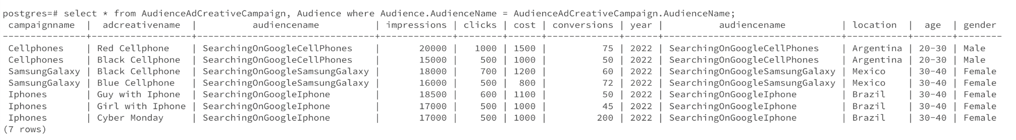
The cross product equivalent to the "natural join" query above: This query does the same as the query in the previous slide, but using cross-product.
postgres=# select * from AudienceAdCreativeCampaign, Audience where Audience.AudienceName = AudienceAdCreativeCampaign.AudienceName;

Slide 9
A query involving a “Group by”, perhaps also with a “HAVING”: This query shows the sum of the conversions of a campaign, excluding the ads that were used during the Cyber Monday event, and showing only the campaign that have more tan 100 conversions.
postgres=# select campaignname, sum(conversions) as SumOfConversions from AudienceAdCreativeCampaign where adcreativename not like '%Cyber Monday%' group by campaignname having sum(conversions) > 100;

Slide 10
A query which uses a sub query: This query shows the combination of campaign, audience and ad creative that generated the maximum amount of conversions.
postgres=# select campaignname, adcreativename, audiencename, conversions from AudienceAdCreativeCampaign where conversions = (select max(conversions) from AudienceAdCreativeCam
paign);

Slide 11
A cross product which cannot be implemented using the words “natural join” (e.g. self join): This query shows the ads that had more conversions than the ad called ‘Blue Cellphone’. It also shows the campaigns to which these ads belong.
select aud1.adcreativename, aud1.campaignname, aud1.conversions from AudienceAdCreativeCampaign aud1, AudienceAdCreativeCampaign aud2 where aud1.conversions > aud2.conversions and aud2.adcreativename = 'Blue Cellphone';

Slide 12
Check statements:
CONSTRAINT co_Ad_Network
CHECK (AdNetworkName IN ('Google Ads’))
CONSTRAINT co_Sub_Network
CHECK (SubNetworkName IN ('Google Ads Search', 'Google Ads Display’))
CONSTRAINT co_CampaignType
CHECK (CampaignTypeName IN ('Prospecting', 'Remarketing’))
CONSTRAINT co_Age
CHECK (Age IN ('20-30', '30-40', '40-50', '50-60', '60-70', '70-80’))
CONSTRAINT co_Gender
CHECK (Gender IN ('Male', 'Female’))
CONSTRAINT co_impressions
CHECK (Impressions >= 0),

Slide 13
Check statements:
CONSTRAINT co_clicks
CHECK (Clicks >= 0)
CONSTRAINT co_cost
CHECK (Cost >= 0)
CONSTRAINT co_conversions
CHECK (Conversions >= 0)
CONSTRAINT co_year
CHECK (Year >= 1990)

Slide 14
Action statements:
CONSTRAINT AudienceAdCreativeCampaignFK_Audience FOREIGN KEY (AudienceName) REFERENCES Audience
ON DELETE RESTRICT
ON UPDATE CASCADE,
CONSTRAINT AudienceAdCreativeCampaignFK_AdCreative FOREIGN KEY (AdCreativeName) REFERENCES AdCreative
ON DELETE CASCADE
ON UPDATE CASCADE,

Slide 15
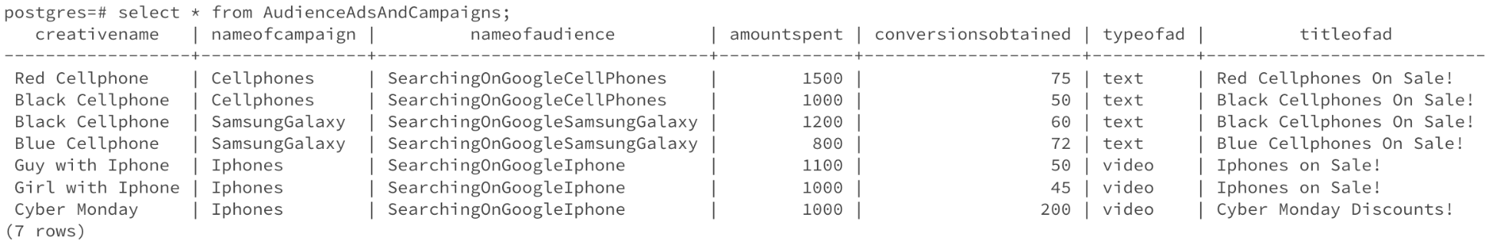
View:
CREATE VIEW AudienceAdsAndCampaigns AS SELECT AdCreativeName as CreativeName, CampaignName as NameOfCampaign, AudienceName as NameOfAudience, Cost as AmountSpent, Conversions as ConversionsObtained, AdType as TypeOfAd, AdTitle as TitleOfAd FROM AudienceAdCreativeCampaign natural join AdCreative;

